Slide 1
PLANNING A SOFTWARE PROJECT
Dr. Rachna Patel

Slide 2
6.1 INTRODUCTION
The first step to be taken in project management is project planning. There are five major activities that are performed in project planning
1. Project estimation
2. Project scheduling
3. Risk analysis
4. Quality management planning
5. Change management planning
Software estimation begins with a description of the scope of software product.
For the meaningful project development the scope must be bounded. The problem for which the product is to be built is then decomposed into a set of smaller problems. Each of these is estimated using historical data (metrics) and / or previous experience as a guide. The two important issues problem complexity and risk are considered before final estimate is made.

Slide 3
CONTI…
There are many useful techniques for time and effort estimation. Process and project metrics can provide historical perspective and powerful input for generation of quantitative estimates.
Estimation of recourses, cost and schedule for a software engineering effort requires-
Experience
Access to good historical information (metrics) and
The courage to commit to quantitative predictions when quantitative information is available.
While estimating the project, both the project planner and the customer should recognize that variability in software requirement means instability in cost and schedule. When customer changes the requirements, then estimation needs to be revisited.

Slide 4
6.2 SCOPE AND FEASIBILITY
Software scope describes four things -
O The function and features that are to be delivered to end-users.
O The data which can be input and output.
O The content of the software that is presented to user.
O Performance, constraints, reliability and interfaces that bounds the System.
There are two ways by which the scope can be defined –
1. A scope can be defined using the narrative description of the software obtained after communication with all stakeholders.
2. Scope can be defined as a set of use cases developed by the end users.

Slide 5
CONTI…
In the scope description, various functions are described. These functions are evaluated and refined to provide more details before the estimation of project.
For performance consideration, processing and response time requirements are analyzed.
The constraints identify the limitations placed on the software by external hardware or any other existing system.
After identifying the scope following questions must be asked –
Can we build the software to meet this scope?
Is this software project feasible?
That means after identifying the scope of the project its feasibility must be ensured.
Following are the four dimensions of software feasibility. To ensure fee feasibility of the software project the set of questions based on these dimension has to be answered. Those are as given below -

Slide 6
CONTI…
1. Technology
• Is a project technically feasible?
• Is it within the state of art?
• Are the defects to be reduced to a level that satisfies the application's need?
2. Finance
• Is it financially feasible?
• Is the development cost completed at a cost of software organization, its client or market affordable?
• Are the defects to be reduced to a level that satisfies the application's need?

Slide 7
CONTI…
3. Time
• Will the project's time to market beat the competition?
4. Resource
• Does the organization have the resources needed to succeed?
Putnam and Meyers suggests that scoping is not enough. Once scope is understood, and feasibility have been identified the next task is estimation of the Resources requirement to accomplish the software development effort.

Slide 8
6.3 EFFORT ESTIMATION
After gathering the requirements of the project and after analyzing them it is necessary to know two things about the project-
1. The total time required by the project to get completed.
2. The overall cost of the project.
These estimates are needed before the project gets initiated. Such estimations help in
controlling the project Similarly the requirement of human resource can be we
understood from such estimations.
For any software project, effort estimation means estimating cost and schedule of the project The cost estimation is made in terms of Person-Month(PM).

Slide 9
6.3.1 UNCERTAINTY IN EFFORT ESTIMATION
If the effort is estimated at the start of the project then lot of uncertainty is involved in it. Because of lot of information is unexposed at this stage and complete date about the project is not available. But if the effort estimation is at tire end of tire project then one can estimate efforts accurately, because tire complete knowledge of the project is gained at stage.

Slide 10
6.3.2 BUILDING THE EFFORT ESTIMATION MODEL
Effort estimation model can be viewed as a function whose output will be the effort required accomplishing the project. This function needs the input and input for the estimation model will be the characteristics of the project. The size of the project can be considered to be one. of the inputs required to estimate the effort That means if the project is larger then, lot of efforts will be required.
one commonly used function for estimating effort will be
Effort = a*SIZE ^{b}

Slide 11
CONTI…
where a and b are some constants and SIZE is the size of the project which is in
terms of Kilo Lines of Code(KLOC).
Watson and Felix observed data of more than 60 projects and estimated the values of the constants a and b as
Effort = 5.2*SIZE^{0.91} Where a= 5.2 and b=0.91
The effort is denoted in terms of Person-Months(PM)
• The productivity can be computed as
P = KLOC/PM

Slide 12
CONTI…
• This approach of obtaining the Effort is called top down approach. Because in this approach effort is computed from the size of the project. The effort estimation for the overall project is obtained and then the effort required by the various tasks of the project is computed in the top down approach.
• The disadvantage of the top down approach is that the effort estimation in this approach is based on the size of the project. But if the size estimation of the project is inaccurate then the effort estimation will be wrong.
• Another approach of estimating the effort is bottom up approach. In this approach, the project is partitioned into smaller tasks. Then it becomes very easy to obtain effort estimation for these small tasks. The overall effort estimation will then be a sum of the efforts needed by the small tasks.
• The risk of bottom up approach is that there are chances of omitting the list of important activities from particular task. This will result in wrong computation of effort estimation for the project.

Slide 13
6.3.3 BOTTOM-UP ESTIMATION APPROACH
• If the System that has to be developed has a past information about the effort distribution over different phases then the bottom up approach need not have to enlist all the tasks. Such approach is used in commercial organizations.
• In this approach, the major modules of the system are identified. These modules are then categorized into simple, medium and complex based on certain criteria. For each classified unit, average effort for coding is estimated. This estimation is based on past experience of the system. From the estimation of the coding effort, the estimates for die other phases is obtained and then overall effort estimates for the project can be computed.

Slide 14
CONTI…
• Following are the steps to estimate the effort using the bottom up approach in which past information is used -
1. Identify the modules in the project.
2. Classify them as simple, medium and complex modules.
3. Get the coding effort for each module of different types.
4. Using the effort distribution for the similar project estimate the efforts for other tasks. Then obtain the total effort required by the whole project.
5. Refine the estimate based on some factors.
This is a simple approach of estimating the effort.

Slide 15
COCOMO ESTIMATION MODEL
COCOMO is one of the most widely used software estimation models in the world. This model is developed in 1981 by Barry Boehm to give an estimate of the number of man-months it will take to develop a software product. COCOMO predicts the efforts and schedule of a software product based on size of the software. COCOMO stands for "COnstructive COst MOdel".
COCOMO has three different models that reflect the complexity
Basic model
Intermediate model
Detailed model.
Similarly there are three classes of software projects.

Slide 16
CONTI…
Organic mode - In this mode, relatively small, simple software projects with a small team are handled. Such a team should have good application experience to less rigid requirements.
Semi-detached projects - In this class an intermediate projects in which teams with mixed experience level are handled. Such projects may have mix of rigid and less than rigid requirements.
Embedded projects - In this class, projects with tight hardware, software and operational constraints are handled.

Slide 17
CONTI…
Let us understand each model in detail.
Basic model - The basic COCOMO model estimates the software development effort using only Lines of Code. Various equations in this model are -
E = a_{b} (KLOC)^{bb}
D = C_{b}(E)^{db}
P = E/D
where E is the effort applied in person-months.
D is the development time in chronological months.
KLOC means kilo line of code for the project.
P is total number of persons required to accomplish the project.

Slide 18
CONTI…
The coefficients a_{b}, b_{b}, c_{b}, d_{b} for three modes are as given below.
Software projects | ab | bb | Cb | db
Organic | 2.4 | 1.05 | 2.5 | 0.38
Semi-detached | 3.0 | 1.12 | 2.5 | 0.35
Embedded | 3.6 | 1.20 | 2.5 | 0.32

Slide 19
CONTI…
Merits of Basic COCOMO Model
Basic COCOMO model is good for quick, early, rough order of magnitude estimates of software project.
Limitations of Basic Model
The accuracy of this model is limited because it does not consider certain factors for cost estimation of software. These factors are hardware constraints, personal quality, and experience, modem techniques and tools.
The estimates of COCOMO model are within a factor of 1.3 only 29 % of the time and within the factor of 2 only 60 % of time.

Slide 20
Example
Consider a software project using semi-detached mode with 30,000 lines of code. We will obtain estimation for this project as follows -
Effort estimation
E = a_{b} (KLOC)^{bb}
i.e. E = 3.0(30)^{1.12} where lines of code = 30000 = 30 KLOC
E = 135 person-month
Duration estimation
D = C_{b}(E)^{db}
= 2.5(135)^{0.35}
D = 14 months
Persons estimation
P = E/D
= 135/14
P = 10 persons approximately

Slide 21
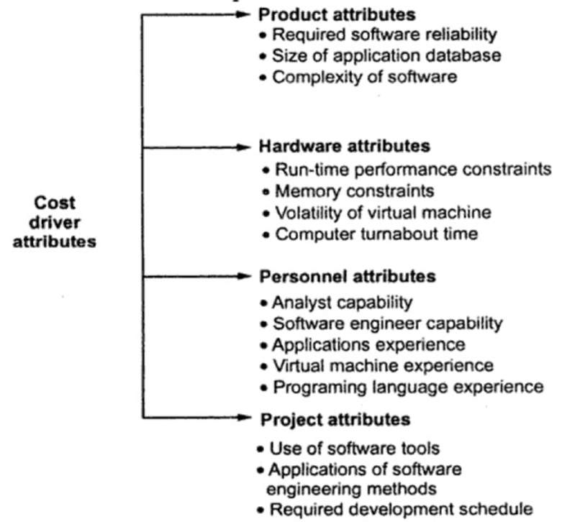
INTERMEDIATE MODEL
This is an extension of basic COCOMO model. This estimation model makes use of set of "cost driver attributes" to compute the cost of software.

Slide 22
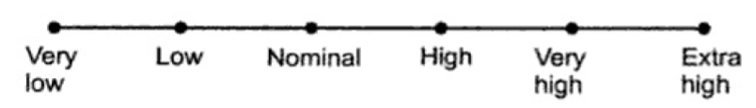
CONTI…
Now these 15 attributes get a 6-point scale ranging from "very low" to "extra high". These ratings can be viewed as
The effort multipliers for each cost driver attribute is as given in following table. The product of all effort multipliers result in "effort adjustment factor" (EAF).

Slide 23
Cost drivers | Ratings
 | Very low | Low | Nominal | High | Very high | Extra high
Product attributes
Required software reliability | 0.75 | 0.88 | 1.00 | 1.15 | 1.40
Size of application database |  | 0.94 | 1.00 | 1.08 | 1.16
Complexity of software | 0.70 | 0.85 | 1.00 | 1.15 | 1.30 | 1.65
Hardware attributes
Run-time performance constraints |  |  | 1.00 | 1.11 | 1.30 | 1.66
Memory constraints |  |  | 1.00 | 1.06 | 1.21 | 1.56
Volatility of virtual machine |  | 0.87 | 1.00 | 1.15 | 1.30
Computer turnabout time |  | 0.87 | 1.00 | 1.07 | 1.15
Personnel attributes
Analyst capability | 1.46 | 1.19 | 1.00 | 0.86 | 0.71
Software engineer capability | 1.42 | 1.17 | 1.00 | 0.86 | 0.70
Applications experience | 1.29 | 1.13 | 1.00 | 0.91 | 0.82
Virtual machine experience | 1.21 | 1.10 | 1.00 | 0.90
Programming language experience | 1.14 | 1.07 | 1.00 | 0.95
Project attributes
Use of software tools | 1.24 | 1.10 | 1.00 | 0.91 | 0.82
Applications of software engineering methods | 1.24 | 1.10 | 1.00 | 0.91 | 0.83
Required development schedule | 1.23 | 1.08 | 1.00 | 1.04 | 1.10

Slide 24
CONTI…
The formula for effort calculation can be -
E = ai (KLOC)^{bi} • EAF person-months
The values for a_{i} and b_{i} for various class of software projects are
The duration and person estimate is same as in basic COCOMO model, i.e.
D = c_{b}(E)^{db} months i.e. use values of c_{b} and d_{b} coefficients
P = E/D persons
Software project | ai | bi
Organic | 3.2 | 1.05
Semi-detached | 3.0 | 1.12
Embedded | 2.8 | 1.20

Slide 25
CONTI…
Merits of Intermediate Model
This model can be applied to almost entire software product for easy and rough cost estimation during early stage.
It can also be applied at the software product component level for obtaining more accurate cost estimation.
Limitations of Intermediate Model
The effort multipliers are not dependent on phases.
A product with many components is difficult to estimate.

Slide 26
EXAMPLE
Consider a project having 30,000 lines of code which is an embedded software with critical area hence reliability is high. The estimation can be
E = a_{i}(KLOC)^{bi} EAF
As reliability is high, EAF = 1.15 (product attribute)
a_{i}=2.8 and b_{i}=1.2 for embedded software

Slide 27
CONTI…
E = 2.8(30)^{1.20} *1.15
= 191 person-month
D = C_{b}(E)^{db}
= 2.5(191)^{0.32}
= 13 months approximately
P = E/D = 191/13
P = 15 persons approximately

Slide 28
CONTI…
Detailed COCOMO model : The detailed model uses the same equations for estimation as the Intermediate Model. But detailed model can estimate the effort (E), duration (D) and persons (P) of each of development phases, subsystems, modules.
The experimentation with different development strategies is allowed in this model.
Four phases used in detailed COCOMO model are
Requirements Planning and Product Design (RPD)
Detailed Design (DD)
Code and Unit test (CUT)
Integrate and Test (IT).
The effort multipliers for detailed COCOMO are

Slide 29
CONTI…
Using these detailed cost drivers, an estimate is determined for each phase of the life cycle.
Phases | Very low | Low | Nominal | High | Very high
RPD | 1.80 | 0.85 | 1.00 | 0.75 | 0.55
DD | 1.35 | 0.85 | 1.00 | 0.90 | 0.75
CUT | 1.35 | 0.85 | 1.00 | 0.90 | 0.75
IT | 1.50 | 1.20 | 1.00 | 0.85 | 0.70

Slide 30
6.4 SCHEDULE AND STAFFING
• After estimating the effort for the overall project it becomes easy to estimate two things and those are 1) Duration (Schedule) and 2) People(Resource)
• The schedule and people are not fully interchangeable in the software project
For instance if the effort required is 36 person-month then it is hard to say that within 6 months and with the help of 6 people one can complete the project or with the help of 9 people the same project cane be completed within 4 months.
• Empirical data suggests that there is no simple equation between effort and schedule fits well.
• In project the scheduling can be done using two simple activities -
1. Determining overall schedule by using different important milestones.
2. Developing detailed schedule for different tasks.

Slide 31
6.4.1 OVERALL SCHEDULING
• The overall schedule for the project can be obtained using the effort as the function. This function is designed from the data available from the past similar projects.
• The IBM Federal Systems Division has found that total duration M is estimated in terms of month as .
M = 4.1 E ^{0.36}
• In COCOMO equation the effort estimation will be
M = 2.5 E ^{0.38}
• From these equations it is clear that, the schedule is not entirely dependent upon the effort estimate. Hence the schedule obtained in this manner is not fixed. But these figures can be used as some guideline.

Slide 32
CONTI…
• Square root check is another method which can be used to obtain the estimate for the schedule. For the medium sized projects the proposed schedule can be around square root of the total effort in terms of person-months. That is if the effort estimate is 36 person-months then the schedule is about 6 to 7 months. From this estimate, we can determine the schedule for the major milestones in the project.
• Before determining the milestones, it is required to find the man-power requirement for the project. The number of people involved in the project tends to follow the Rayleigh Curve. By this curve, the number of people involved in the project at the beginning and at the end is less in number. But near the middle of the project the number of people requirement is at the peak. This is because very few people are required for requirement analysis. Similarly the requirement of people for system testing and integration is less. But for coding and unit testing large number of people are required.

Slide 33
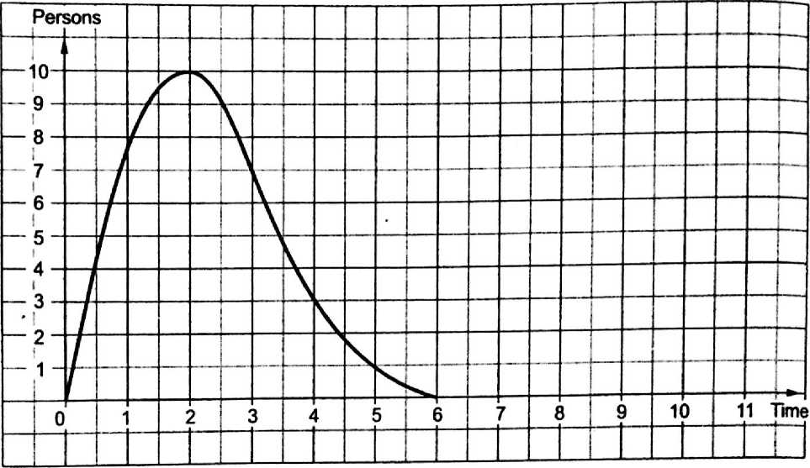
CONTI…
Generally speaking, the design requires about quarter of the schedule, coding and unit testing consumes about half and integration and system testing requires remaining quarter.

Slide 34
6.5 QUALITY PLANNING
In quality plan, various quality activities are enlisted. The quality plan specifies the quality control tasks that will be performed for the project. For example, the quality plan specifies the code being inspected, the document that are examined, the tests that are conducted. The quality control tasks enlisted in the quality plan help in monitoring the overall quality of the project. The quality plan revolves around the testing and reviews.

Slide 35
6.6 RISK MANAGEMENT
Definition : Risk can be defined as the exposure to injury or loss. In case of software project, risk refers to an adverse effect on cost, quality and schedule of the project.
Risk management is an area in which the negative effect on cost, schedule and quality of the project can be minimized.
During the risk management, commonly occurring unexpected events are handled. For example change in technology, people leaving the projects are some commonly occurring events that can be handled in risk management.

Slide 36
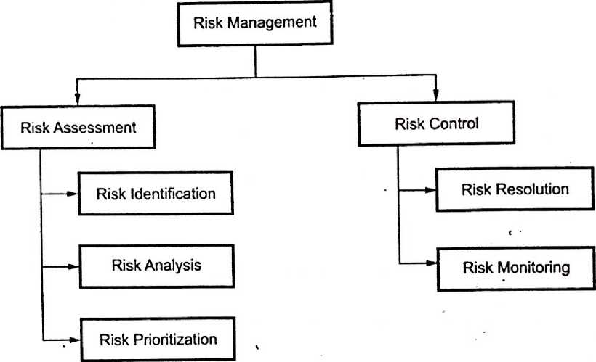
CONTI…
In Risk Management, the effect of risk is minimized. .
Risk management revolves around two things - risk assessment and risk control.

Slide 37
6.6.1 TYPES OF RISK
Reactive and proactive risk strategies are the approaches used for managing the risks.
Reactive risk strategy
• Reactive risk management is a risk management strategy in which when project, gets into trouble then only corrective action is taken. But when such risks can not be managed and new risks come up one after the other, the software team flies into action in an attempt to correct problems rapidly. These activities are called "firefighting" activities.
• Resources are utilized to manage such risks. And if still the risks do not get managed then project is in danger.
• In this strategy no preventive care is taken about the risks. They are handled only on their occurrences.
• This is an older approach of risk management.

Slide 38
CONTI…
Proactive risk strategy
• Proactive risk management strategy begins before the technical activity by considering the probable risk.
• In this strategy potential risks are identified first then their probability and impact is analyzed. Such risks are then specified according to their priorities (i.e. high priority risks should be managed first). Finally the software team prepares a plan for managing these risks.
• The objective of this strategy is to avoid the risk (prevention is better than cure!!!) But it is not possible to avoid all the risks, hence team prepares the risk management plan in such a manner that risk controlling can done efficiently.
• This is an intelligent strategy for risk management and now a day it is used by most of the IT industries.

Slide 39
6.7 RISK IDENTIFICATION
Risk identification can be defined as the efforts taken to specify threats to the project plan. Risks identification can be done by identifying the known and predictable risks.
The risk identification is based on two approaches
1. Generic risk identification - It includes potential threat identification to software project.
2. Product-specific risk identification - It includes product specific threat identification by understanding people, technology and working environment in which the product gets built.
Normally the risk identification is done by the project manager who follows following steps -

Slide 40
CONTI…
Step 1 : Preparation of risk item check list
The risk items can be identified using following known and predictable components.
Product size: The risk items based on overall size of the software product is identified.
Business impact: Risk items related to marketplace or management can be predicted.
Customer characteristics: Risk associated with customer developer communication can be identified.
Process definition: Risk that get raised with the definition of software process. This category exposes important risks items because whichever is the process definition made, is then followed by the whole team.
Development environment: The risks associated with the technology and tool being used for developing the product.
Staff size and experience: Once the technology and tool related risks items are identified it is essential to identify the risk associated with sufficient highly experiences and skilled staff who will do the development.
Technology to be built: Complexity of the system should be understood and related risk item needs to be identified.

Slide 41
CONTI…
After preparing a risk item checklist a questionnaire is prepared. These set of questions should be answered and based on these answers the impact or seriousness of particular risk item can be judged.
Step 2 : Creating risk components and drivers list.
The set of risk components and drivers list is prepared along with their probability of occurrence. Then their impact on the project can be analysed.
Let us understand which are the risk components and drivers.

Slide 42
6.7.1 RISK COMPONENTS AND DRIVERS
U.S. Air force has written a guideline for risk identification which is based on identification of risk component and risks drivers. It has suggested following types of risk components
1. Performance risk - It is the degree of uncertainty that the product will satisfy the requirements.
2. Cost risk - It is the degree of uncertainty that die project will maintain the budget.
3. Support risk - It is the degree of uncertainty that the software project being developed will be easy to correct, modify or adapt.
4. Schedule risk - It is the degree of uncertainty that the software project will maintain the schedule and the project will be delivered in time.

Slide 43
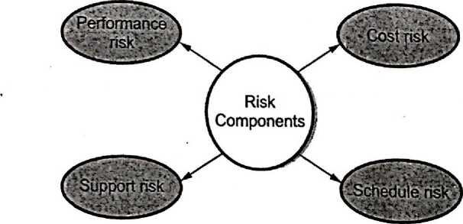
CONTI…
Associated with these components are the risk drivers that are used to analyze the impact of risk. These four risk drivers are listed below
1) Negligible
2) Marginal
3) Critical
4) Catastrophic
For the risk impact assessment a table is built in which impact of each risk driver on each software component can be specified

Slide 44
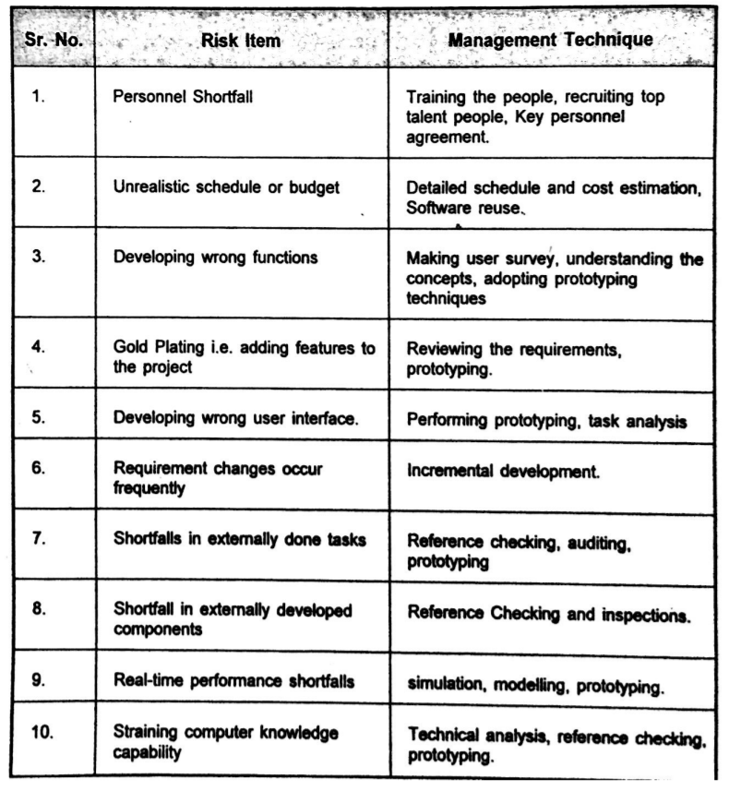
6.8 RISK ASSESSMENT
Risk assessment is done during the project planning. In this phase the identified risks are analyzed and then prioritized on the basis of analysis. The goal of the risk assessment to-prioritize the risks that require an attention.
Bohem has produced a list of top 10 risks items. This list helps in identifying the risks in the project

Slide 45
6.8.1 RISK ANALYSIS AND PRIORITIZATION
• The project planner, technical staff, project manager performs following steps to perform following steps for risk analysis-
o Establish a scale that indicates the probability of risk being real.
o Enlist the consequences of the risk.
o Estimate the impact of the risk on the project and product.
o Maintain the overall accuracy of the risk projection in order to have clear understanding of the software that is to be built.
• These steps help to prioritize the risks. Once the risks are prioritized then it becomes easy to allocate the resources for handling them.
• Building the risk table is the simplest and most commonly used technique adopted by project managers in order to project the risks.

Slide 46
CONTI…
• While building the risk table -
o The project team first of all enlists all probable risks with the help of risk item checklist.
o Each risk is then categorized. As we know various categories of risk can be
o Project size b) Technology c) Customer d) Staff e) Business f) Developing environment.
o Probability of occurrence of each risk is then estimated by each team member individually.
• Then impact of each risk is assessed. While calculating the impact of each risk, each using the cost drivers each component of risk (performance, cost, support, and schedule) is assessed and it then averaged to quote the overall impact of particular risk
• After building this table it is then sorted by probability and impact. The high probability and high impact risks will be at the top of the table. And low probability and low impact risk will be at the bottom of the table. This arrangement of the table is called first-order prioritization.

Slide 47
CONTI…
• Then the project manager goes through this first-order prioritized risk table and draws a horizontal line at some point in the table. This line is called cut-off line. The risks table above the cut-off line is now considered for further risk analysis.
• The risk table below the cut-off line is again sorted and a second-order prioritization.is applied on this table.
• The risk table above the cut-off line is having the risks with high probability and high impact and such risks should occupy the significant amount of management time.
• All the risks that lie above the cut-off line should be managed.

Slide 48
RISK EXPOSURE
The risk exposure can be calculated by following formula
Risk Exposure = Probability of occurrence of risk *Loss due to unsatisfactory outcome
For example : Consider a software project with 77 percent of risk probability in which 15 components were developed from the scratch. Each component have on an average 500 LOC and each LOC have an average cost of $10. Then the risk exposure can be calculated as,
First of all we will compute Loss due to unsatisfactory outcome
= number of components*LOC*cost of each LOC
= 15*500*10
= $75000
Then Risk Exposure = Probability of occurrence of risk *Loss
= 77 / 100 *75000
= $57750
• Thus risk exposure for each risk from risk table is calculated. The total risk exposure of all risks helps in determining the final cost of the projects

Slide 49
6.9 RISK CONTROL
Risk control can be done using three issues
1. Risk avoidance 2. Risk monitoring 3. Risk management. (RMMM)

Slide 50
RISK MITIGATION
Risk mitigation means preventing the risks to occur(risk avoidance). Following are the steps to be taken for mitigating the risks.
1. Communicate with the concerned staff to find of probable risk.
2. Find out and eliminate all those causes that can create risk before the project starts.
3. Develop a policy in an organization which will help to continue the project even though some staff leaves the organization.
4. Everybody in the project team should be acquainted with the current development activity.
5. Maintain the corresponding documents in timely manner. This documentation should he strictly as per the standards set by the organization.
6. Conduct timely reviews in order to speed up the work.
7. For conducting every critical activity during software development, provide the additional staff if required.

Slide 51
RISK MONITORING
In risk monitoring process following things must be monitored by the project manager,
1. The approach or the behavior of the team members as pressure of project varies.
2. The degree in which the team performs with the spirit of "team-work".
3. The type of co-operation among the team members.
4. The types of problems that are occurring.
5. Availability of jobs within and outside the organization.
The project manager should monitor certain mitigation steps. For example.
If the current development activity is monitored continuously then .everybody in the team will get acquainted with current development activity.
The objective of risk monitoring is
1. To check whether the predicted risks really occur or not.
2. To ensure the steps defined to avoid the risk are applied properly or not.
3. To gather the information which can be useful for analyzing the risk.

Slide 52
RISK MANAGEMENT
Project manager performs this task when risk becomes a reality. If project manager is successful in applying the project mitigation effectively then it becomes very much easy to manage the risks.
For example, consider a scenario that many people are leaving the organization then if sufficient additional staff is available, if current development activity is known to everybody in the team, if latest and systematic documentation is available then any 'new comer' can easily understand current development activity. This will ultimately help in continuing the work without any interval.

Slide 53
6.10 PROJECT MONITORING PLAN
Risk Table
Risk | Category | Probability | Impact | RMMM
Is the skilled staff available | Staff | 50 % | Catastrophic
Is that the team size sufficient | Staff | 62 % | Critical
Have the staff received sufficient training | Staff | 25 % | Marginal
Will technology meet the expectations | Technology | 30 % | Critical
Is the software management tool available | Environment | 40 % | Negligible
How much amount of reused software is required? | Project size | 60 % | Marginal ' . .
WII customer change the requirement? | Customer | 20% | Critical
Project plan is a simple document useful for execution of the project. In this plan, the risk analysis activities are described. A sample project monitoring plan is as shown below

Slide 54
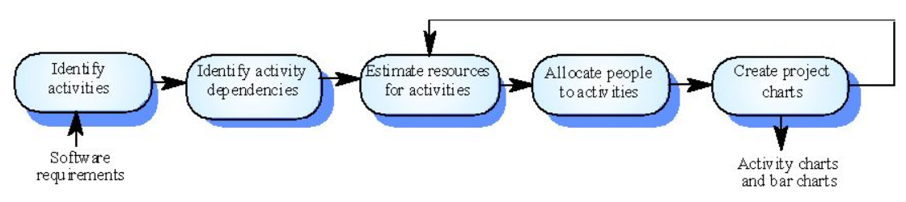
6.11DETAILED SCHEDULING
While scheduling the project, the manager has to estimate the time and resources of the project. All the activities in the project must be arranged in coherent sequence. The schedules must be continually updated because some uncertain problems may occur during the project life cycle. For new projects initial estimates can be made optimistically.
During the project scheduling the total work is separated into various small activities, time required for each activity must be determined by the project manager. For efficient performance some activities are conducted in parallel.

Slide 55
CONTI…
The project manager should be aware of the fact that : Every stage of the project may not be problem-free. Some of the typical problems in project development stage are :
• People may leave or remain absent.
• Hardware may get failed.
• Software resource may not be available.

Slide 56
CONTI…
To accomplish the project within given schedule the required resources must be available when needed. Various resources required for the project are -
• Human effort
• Sufficient disk space on server
• Specialized hardware
• Software technology
• Travel allowance required by the project staff.
Project schedules are represented as the set of chart in which the work-breakdown structure and dependencies within various activities is represented.

Slide 57
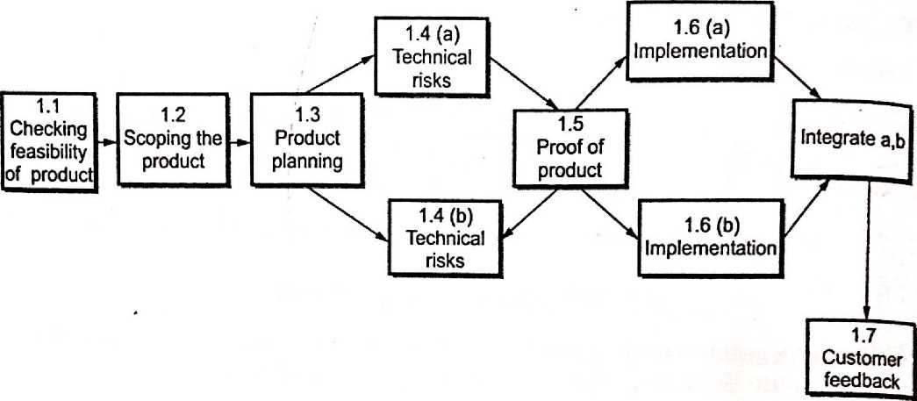
6.11.1 DEFINING TASK NETWORK
• The task is a small unit of work.
• The task network or an activity network is a graphical representation, with :
Nodes corresponding to activities.
Tasks or activities are linked if there is a dependency between them.

Slide 58
CONTI…
• The task network definition helps project manager to understand the project work breakdown structure.
• The project manager should be aware of interdependencies among various tasks.
It should be aware of all those tasks which lie on the critical path.

Slide 59
6.11.2 TIME LINE CHART
• In software project scheduling the timeline chart is created. The purpose of timeline chart is to emphasize the scope of individual, task. Hence set of tasks are given as input to the time line chart.
• The time line chart is also called as Gant chart.
• The time line chart can be developed for entire project or it can be developed for individual functions.
• In time line chart
1) All the tasks are listed at the leftmost column.
2) The horizontal bars indicate the time required by the corresponding task.
3) When multiple horizontal bars occur at the same time on the calendar, then that means concurrency can be applied for performing the tasks.
4) The diamonds indicate the milestones.
• In most of the projects, after generation of time line chart the project tables are prepared. In project tables all the tasks are listed along with actual start and end dates and related information.

Slide 60
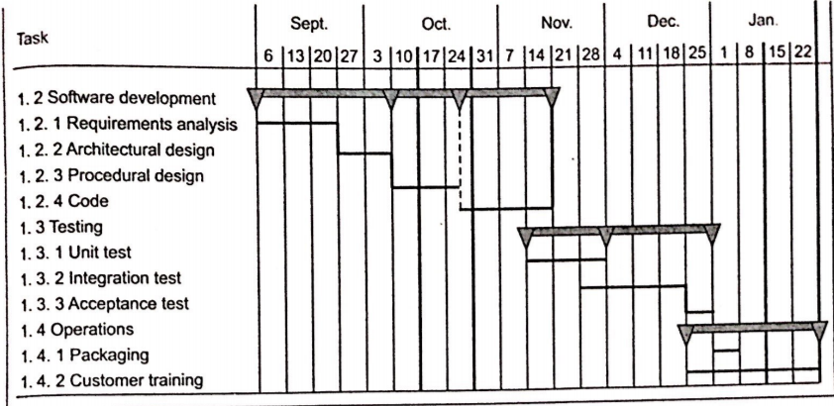
EXAMPLE

Slide 61
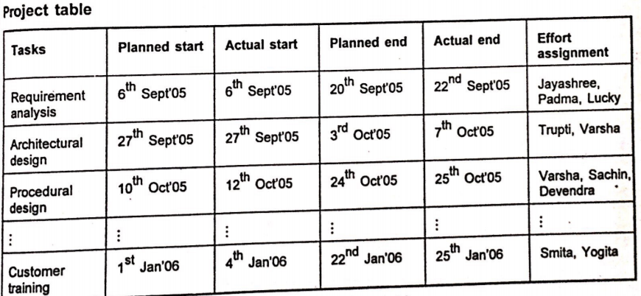
CONTI…

Slide 62
6.11.3 TRACKING SCHEDULE
Project schedule is the most important factor for software project manager. It is the duty of project manager to decide the project schedule and track the schedule.
Tracking the schedule means determine the tasks and milestones in the project as it proceeds.
Following are the various ways by which tracking of the project schedule can be done
1. Conduct periodic meetings. In this meeting various problems related to the project get dismissed. The progress of the project is reported to the project manager.
2. Evaluate results of all the project reviews.
3. Compare 'actual start date' and 'scheduled start date' of each of the project task.
4. Determine if the milestones of the project is achieved on scheduled date.
5. Meet informally the software beginners. This will help the project manager to solve many problems. This meeting will also be helpful for assessing the project progress.
6. Assess the progress of the project quantitatively.

Slide 63
CONTI…
Thus for tracking the schedule of the project the project manager should be an experienced person. In fact project manager is the only responsible person who is controlling the software project. When some problems occur in the project then addition resources may be demanded, skilled and experienced staff may be employed or project schedule can be redefined. For handling the severe deadlines, project manager uses a technique of time boxing. In this technique it is understood that the complete product cannot be delivered on given time. Part by part i.e. in the series of increments the product can be delivered to the customer. The project manager uses time box technique means he is associating each task with a box. That means each task is put in a "time box" and within that time frame each task must be completed. When the current task reaches to boundary of its time box, then tire next task must be started (even if current task is remaining incomplete). Some researchers had argued upon - leaving The task incomplete when current task reaches to the boundary but for this argument the counterpart is that even if the task is remaining incomplete it reaches to almost completion stage and remaining part of it can be completed in the next successive increment.

Slide 64
6.11.4 EARNED VALUE ANALYSIS
• Earned Value Analysis (EVA) is technique of performing quantitative analysis of the software project.
• Earned value system provides a common value scale for every task of software project.
• The EVA acts as a measure for software project progress.
• With the help of quantitative analysis in EVA, we can know how much percentage of the project is completed.
• The earned value analysis can be made using following steps.

Slide 65
CONTI…
The budgeted cost of work scheduled (BCWS) is an estimated cost for the work that has been scheduled. This value is obtained for every individual task in the software project. In this activity the work of each software engineering task is planned. The BCWS_{i} is the effort planned for work task i. Hence at every point in the progress of project the BCWS_{i} are calculated and the total cost is the summation of all the BCWS_{i} .
At the completion of the project the BCWS values for all work tasks are summed to derive the budget of the project The calculation of budgeted actual cost (BAC) is
BAC = ∑ BCWS_{i} for all the tasks i.
Then budgeted cost of work performed (BCWP) is computed. The value of BCWP is the sum of all the BCWS values of all the corresponding tasks that have actually been completed by a point in time on the project schedule.
• The difference between BCWS and BCWP is that BCWS represents Values for the project activities that are planned / and BCWP represents the values of the project activities that are completed.

Slide 66
CONTI…
• Various types of computations in EVA are given as follows
1. SPI = BCWP/BCWS
Where SPI is the software performance index. It represents the project efficiency. If the value of SPI is 1.0 .then it represents that execution of project is very efficient.
2. SV= BCWP-BCWS
Where SV indicates the scheduled variance.
3. Project scheduled for completion = BCWS/BAC
Where project scheduled for completion indicates the percentage of work which should be completed by time t :
Percent complete = BCWP/BAC
Percent complete represents the percent of project which is actually completed by time t.
4. ACWP = ∑ Efforts expended on work task that have been completed by time t.
Where ACWP refers to Actual Cost Work Performance. This value helps in computing the cost factor of the project.

Slide 67
CONTI…
CPI = BCWP/ACWP
Where CPI indicates the cost performance index. This value represents whether the performance of project is within the defined budget or not The value 1.0 indicates that the project is within the defined budget
Thus EVA helps in identifying the project performance, cost of performance and project scheduling difficulties. This ultimately helps the project manager to take the appropriate corrective actions.

Slide 68
6.11.5 ERROR TRACKING
• While developing the software project many work products such as SRS, design document, source code are being created. Along with these work products many errors may get generated. Project manager has to identify all these errors to bring quality software.
• Error tracking is a process of assessing the status of the software project
• The software team performs the formal technical reviews to test the software developed. In this review various errors are identified and corrected. Any errors that remain uncovered and are found in later tasks are called defects.
• The defect removal efficiency can be defined as
DRE = E/(E+D)
where DRE is the defect removal efficiency,
E is the error and D is defect
• The DRE represents the effectiveness of quality assurance activities. The DRE also helps the project manager to assess the progress of software project as it gets developed through its scheduled work task.

Slide 69
CONTI…
• During error tracking activity following metrics are computed
1. Errors per requirements specification page : denoted by F
2. Errors per component - design level: denoted by Edesign
3. Errors per component - code level: denoted by Eg
4. DRE - requirement analysis
5. DRE - architectural design
6. DRE - component level design
7. DRE – coding
The project manager calculates current values for E_{req} , E_{design} , E_{code} .
These value are then compared with past project. If the current result differs more than 20% from the average, then there may be cause for concern and investigation needs to be made in this regard.
• These error tracking metrics can also be used for better target review and testing resources.

Slide 70
6.12 THE RMMM PLAN
A risk management strategy can be included in the software project plan. Or the risk management steps can be organized into a separate risk mitigation, monitoring and management plan (RMMM). The RMMM plan documents all work performed as part of risk analysis and is used by the project manager as part of the overall project plan.
Some software terms do not develop a formal RMMM document. Rather, each risk is documented individually using a risk information sheet (RIS). In most cased , the RIS is maintained using a database system so that creation and information entry, priority ordering, searches, and other analysis may be accomplished easily.

Slide 71
CONTI…
Once RMMM has been documented and the project has begun, risk mitigation and monitoring steps commence. As I have already discussed, risk mitigation is a problem avoidance activity. Risk monitoring is a project tracking activity with three primary objectives:
1. To access whether predicted risk do, in fact, occur;
2. To sure that risk avoidance step defined for the risk are being properly applied
3. To collect information that can be used for future risk analysis.
Problems that occur during a project can be traced to more than one risk.
Another job of risk monitoring is to attempt to allocate origin (what risk(s) caused which problems throughout the project).

Slide 72
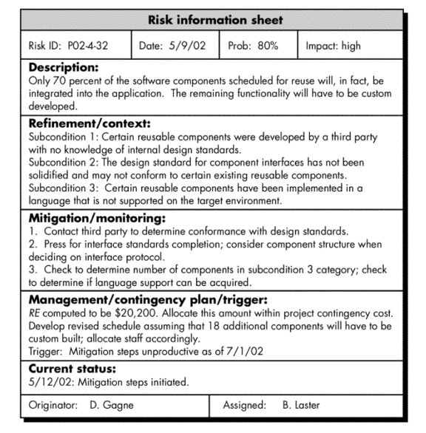

Slide 73
MATH PUZZLE
1) How can you add eight 8’s to get the number 1000? (only use addition)
2) If 9999 = 4, 8888 = 8, 1816 = 3, 1212 = 0, then 1919 = ?
3) Can you find four consecutive prime numbers that add up to 220?
4) Divide 20 by half and add 30, what do you get?

Slide 74
ANSWER
1) 888+88+8+8+8=1000
2) 2 because there are two nine and each 9 has 1 hole
3) 47+53+59+61=220
4) 20/ (1/2) + 30 = 70

Slide 75
MATH PUZZLE
5) 1
1 1
2 1
1 2 1 1
1 1 1 2 2 1
? ? ? ? ? ?
? ? ? ? ? ? ? ?

Slide 76
3 1 2 2 1 1
1 3 1 1 2 2 2 1
1) Line 1 is Two ones ( 2 1)
2) Line 2 Then become

Slide 77
Thank you

